Slide 1
Class 3 PMR for 19 Sites in Pueblo Canyon
Emily Day, Director of Regulatory Compliance
Jennifer von Rohr, Environmental Professional with Regulatory Compliance
November 9, 2021

Slide 2
Objective
Objective
The purpose of this meeting is to:
  Provide information included in Class 3 Permit Modification Request (PMR) submitted to NMED on September 30, 2021
  Requested 19 sites be moved from Table K-1 – SWMUs/AOCs requiring Corrective Action to Table K-3 – SWMUs and AOCs Corrective Action Complete Without Controls
    For purposes of this presentation, “Site” means: a Solid Waste Management Unit (SWMU) or Area of Concern (AOC) and are areas potentially contaminated from historical LANL operations
If the PMR is approved by NMED:
  Sites don’t pose a risk to human health or environment
  No further investigation/remediation/monitoring required
  Sites moved from Table K-1 to Table K-3 of Permit

Slide 3
Regulatory Process
The Consent Order sets forth a process for characterizing the nature and extent of contaminant releases from sites
Note: Each phase of investigation is approved by NMED
Nature and extent of contaminant releases is determined by performing investigations (i.e., samples of environmental media)
Investigation Work Plan
Field Investigation (sometimes multiple phases)
Investigation Report w/ risk assessment
Certificate of Completion (CoC) Request

Slide 4
Regulatory Process, Cont’d
Sampling and analysis is performed
Samples are evaluated to characterize nature and extent of contamination and human health and ecological risk
The investigation methods, results, conclusions, and recommendations are documented in an investigation report that is submitted to NMED for review and approval
The conclusions section for each site included in the investigation report identifies whether nature and extent of contamination is defined and whether the site poses a potential unacceptable risk to human health and ecological receptors
Based on these conclusions, the recommendations for a site may include:
  Additional characterization sampling and/or remediation,
  Corrective-action-complete with controls, or
  Corrective-action-complete without controls
Notes:
It should be noted that:
Additional characterization sampling will be recommended if nature and extent of contamination is not defined.
Remediation will be recommended if the site poses a potential unacceptable risk to human health under current or reasonably foreseeable future land use and/or potential unacceptable risk to ecological receptors.
Corrective-action-complete may be recommended for a site if nature and extent of contamination are defined and the site poses no potential unacceptable risk to human health under current and reasonably foreseeable future land use and poses no potential unacceptable risk to ecological receptors.
If the site poses a potential unacceptable human health risk under the residential scenario, but the current or reasonably foreseeable future land use does not include residential use, the site may be recommended for corrective-action-complete with controls. In this case, the controls would include administrative controls to prevent future residential use.
If the site does not pose a potential human health risk under the residential scenario and any other applicable scenario (e.g., recreational scenario for sites where hiking may occur, construction worker scenario for sites where excavation associated with construction may occur), and poses no potential unacceptable risk to ecological receptors, the site may be recommended for corrective-action-complete without controls.
That is, consistent with Section XXI.D of the Consent Order, corrective-action-complete without controls is only recommended if institutional and/or physical controls, including land use restrictions, are not needed to prevent unacceptable risk to human health or ecological receptors.

Slide 5
Regulatory Process, Cont’d
NMED has established target risk levels of 10⁻⁵ (1 in 100,000) lifetime excess cancer risk for carcinogenic contaminants and a hazard index (HI) of 1 for non-carcinogenic contaminants
  If risk of developing cancer is greater than 1 in 100,000 people for carcinogenic (cancer-causing) contaminants and/or a HI greater than 1 for non-carcinogenic contaminants – the site poses an unacceptable risk to human health
Following NMED review and approval of an investigation report (or other document) recommending corrective complete with or without controls for sites, DOE may request COCs for those sites
  COCs are intended to document completion of corrective action activities and assign controls, if necessary, at sites covered by the Consent Order
Following review of the COC request and determination that corrective action requirements under the Consent Order have been met, NMED will approve the request and issue the COC(s)

Slide 6
Regulatory Process, Cont’d
The corrective action status of sites is tracked in Appendix A of the Consent Order and documented in Attachment K (Listing of SWMUs and AOCs) to the Hazardous Waste Facility Permit. Attachment K consists of three tables containing lists of sites:
  Table K-1 - SWMUs and AOCs Requiring Corrective Action, lists the sites currently subject to corrective action requirements (i.e., sites being investigated or remediated, or planned for investigation or remediation)
  Table K-2 - SWMUs and AOCs Corrective-Action-Complete With Controls, lists sites having COCs with controls
  Table K-3 - SWMUs and AOCs Corrective-Action-Complete Without Controls, lists sites having COCs without controls, or approved for no further action by NMED before the effective date of the Consent Order

Slide 7
Regulatory Process, Cont’d
After NMED has issued a COC for a site, DOE may submit a request to NMED to modify the Hazardous Waste Facility Permit to move the site from Table K‑1, K‑2, or K‑3
The permit modification request must be submitted as a Class 3 (greatest amount of public participation) and the following must occur:
  Notify all persons on the facility mailing list,
  Publish a notice in a major local newspaper,
  Hold a public meeting during the public comment period
  60-day public comment period
After the conclusion of the 60-day comment period, NMED must consider and respond to all significant written comments before granting or denying the permit modification request

Slide 8
Permit Modification Request
On September 30, 2021, EM-LA/N3B submitted a Class 3 PMR to move 19 sites from Table K-1 to Table K-3 of the RCRA Permit
List of Corrective-Action-Complete Sites in Pueblo Canyon Aggregate Area
SWMU/AOC | Number | Description | COC Approval Date
SWMU | 00-018(a) | Former Sludge-Bed Wastewater Treatment Plant, Pueblo Canyon | 1/28/2015
AOC | 00-018(b) | Sludge-Bed Wastewater Treatment Plant | 1/14/2011
AOC | 00-030(d) | Septic Tank | 12/30/2008
AOC | 00-030(eN) | Septic Tanks | 12/30/2008
AOC | 00-030(j) | Septic Tank | 12/30/2008
AOC | 00-030(n) | Former Septic Tank | 12/30/2008
AOC | 00-030(o) | Septic Tank | 12/30/2008
AOC | 00-030(p) | Septic Tank | 12/30/2008
SWMU | 00-039 | Soil Contamination from Former USTsª | 12/30/2008
AOC | C-00-043 | Former Manhole | 12/30/2008
SWMU | 19-001 | Septic System | 6/27/2006
SWMU | 19-002 | Surface Disposal Site | 6/27/2006
SWMU | 19-003 | Drainline and Outfall Associated with Former Building 19-05 | 6/27/2006
SWMU | 45-001 | Soil Contamination from Former RLW^{b} Treatment Plant | 2/22/2013
SWMU | 45-002 | Soil Contamination from Former Decontamination Facility | 2/22/2013
SWMU | 45-003 | Soil Contamination from Former Waste Lines | 2/22/2013
SWMU | 45-004 | Sanitary Sewer Outfall | 2/22/2013
AOC | C-45-001 | Soil Contamination from Spill in Parking Lot South of Former RLW | 2/22/2013
SWMU | 73-004(c) | Septic System | 1/23/2008
a- UST: Underground storage tank
b- RLW: Radioactive liquid waste

Slide 9
Permit Modification Request

Slide 10
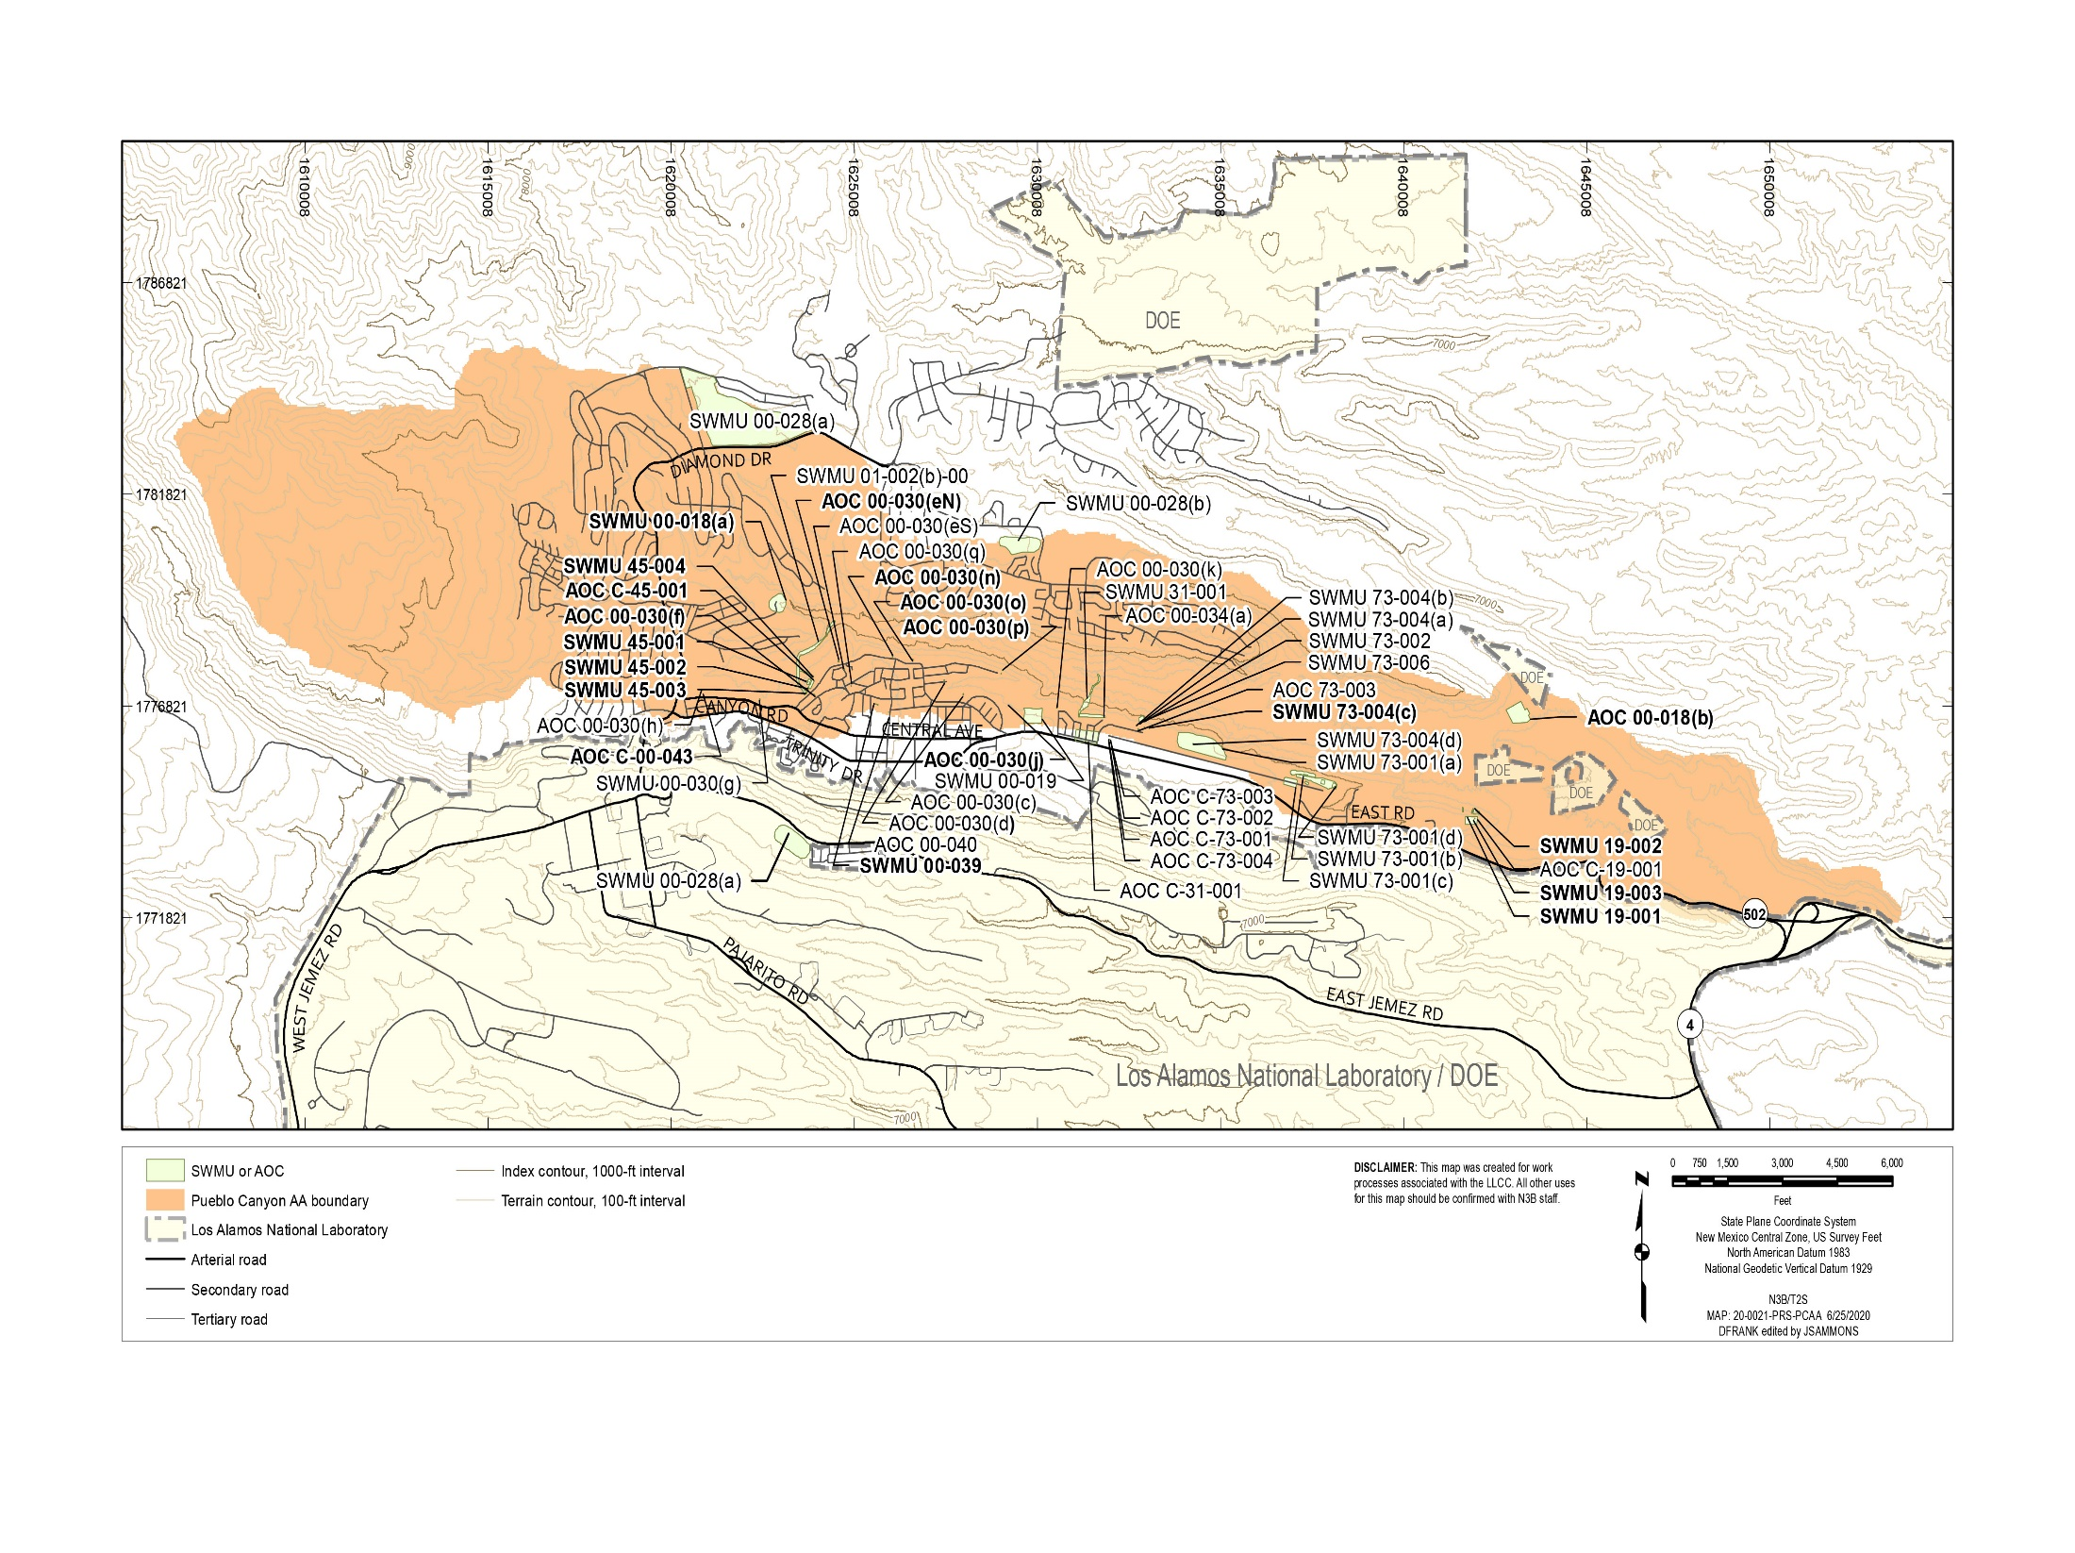
Permit Modification Request
19 sites included in this PMR in bold

Slide 11
Permit Modification Request
Information included for each site in the PMR:
  Description of the site (e.g., location, type of unit, contaminants of concern, sources, etc.)
  Investigation phases and dates of NMED Certificate of Completion (CoC) approval for each site (e.g., Investigation Wok Plan (IWP), Investigation Report (IR), CoC)
  Human Health and ecological screening results for each site
  Links to each of the referenced documents in NMED library

Slide 12
Permit Modification Request
Example:
  Site Name/#: SWMU 00-018(a) Former Sludge-Bed Wastewater Treatment Plant, Pueblo Canyon
  Site Description: SWMU 00-018(a) consists of the former Pueblo Canyon wastewater treatment plant (WWTP) located on Los Alamos County property (Figure 2.1-1). The plant was built between 1946 and 1948, began operating in 1951, and was decommissioned during 1991 and 1992. Final decontamination and decommissioning (D&D) of the plant occurred in 2008. The plant primarily received waste from Los Alamos businesses and residences, including the Los Alamos Medical Center. The plant may have received waste from the LANL Technical Area 43 (TA-43) Health Research Laboratory (HRL). Major components of the WWTP included a primary settling tank, trickling filter, final settling tank, sludge digestion tank, chlorine contact chamber, and six sand-filter sludge drying beds. Sometime during the operational history of the Pueblo Canyon WWTP, dried sludge from the older sludge beds was land-applied in an area to the east/southeast of the sludge drying beds. When the Pueblo Canyon WWTP was decommissioned in 1991 and 1992, sludge remaining in the digestion tank was transferred to the eastern sludge drying bed.
  Phases of Investigation: IWP, Phase 1 IR, Phase II IR, CoC w/o Controls

Slide 13
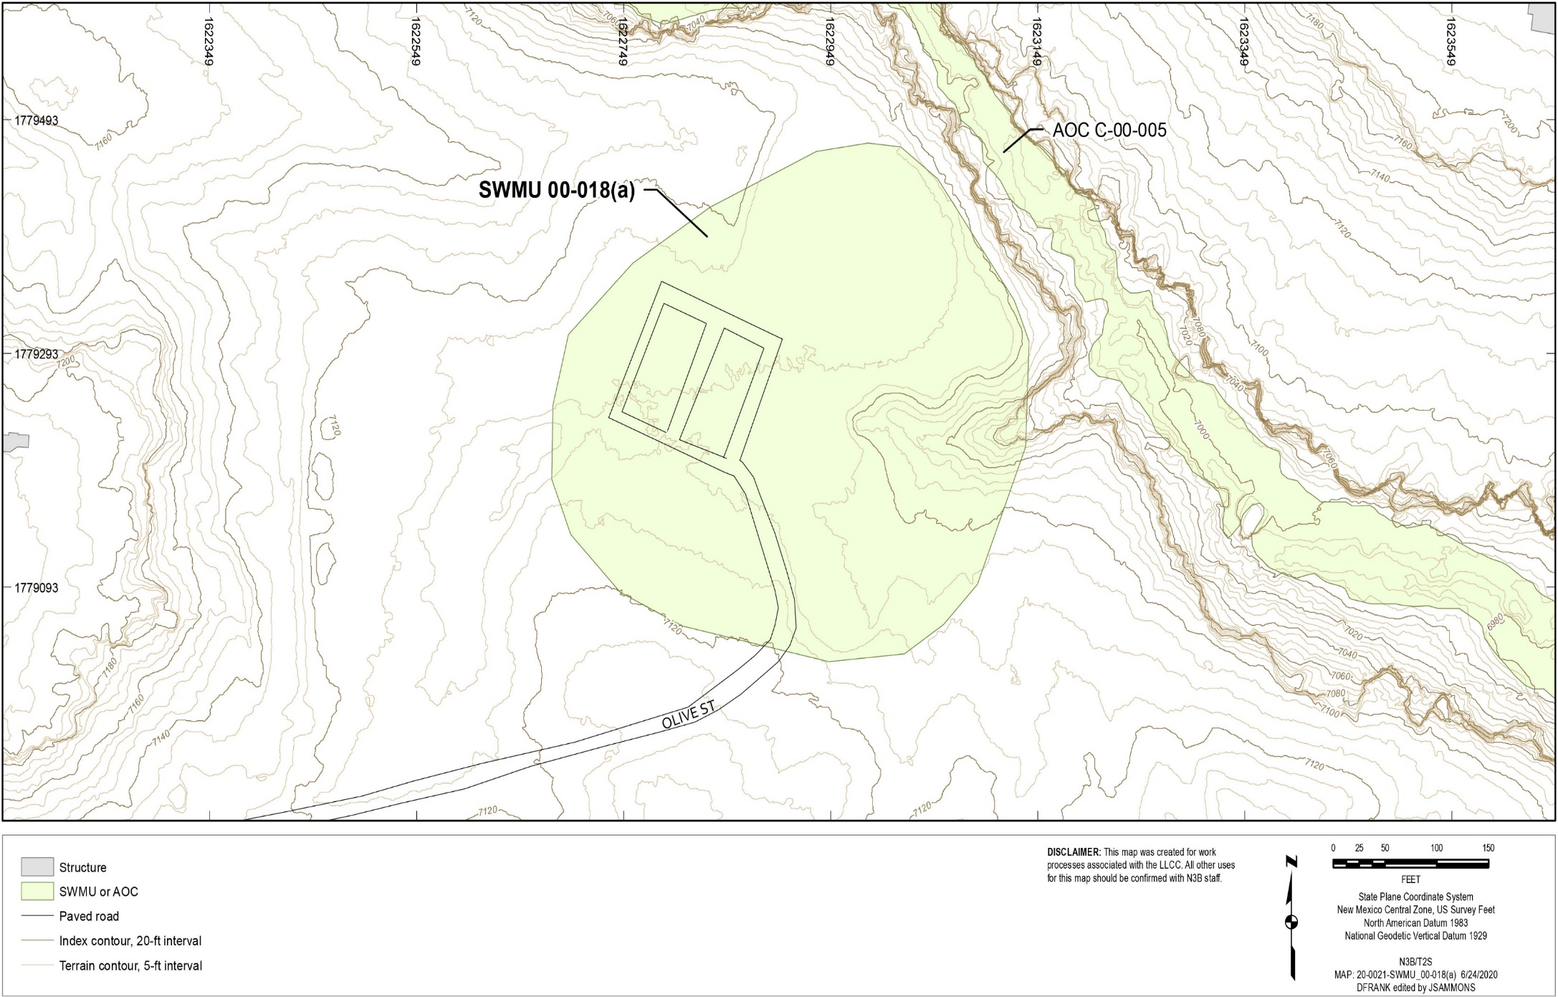
Permit Modification Request

Slide 14
Permit Modification Request
Example Cont’d:
  Human Health/Ecological Risk: The results of the human health risk-screening assessment for this site showed that it achieved NMED’s standards and poses no unacceptable risk to human health or the environment.
  Reference Documents for SWMU 00-018(a)
Document Date | Title | NMED Document Number
1/28/2015 | Certificate of Completion, One Solid Waste Management Unit 00-018(a), Pueblo Canyon Aggregate Area | 36922
10/21/2014 | Request for Certificate of Completion for One Solid Waste Management Unit in the Pueblo Canyon Aggregate Area – SWMU 00-018(a) | 36633
9/30/2010 | Phase II Investigation Report for Pueblo Canyon Aggregate Area | 33980
7/25/2008 | Investigation Report for Pueblo Canyon Aggregate Area, Revision 1 | 30037

Slide 15
Next Steps
Public Comment Period ends 12/5/21
  Comments should be sent to:
  Neelam Dhawan
  New Mexico Environment Department
  Hazardous Waste Bureau
  2905 Rodeo Park Drive East, Building 1
  Santa Fe, NM 87505-6313
  Neelam.Dhawan@state.nm.us
    Arturo Duran
    U.S. Department of Energy
    Environmental Management
    Los Alamos Field Office
    1200 Trinity Drive, Suite 400
    Los Alamos, NM 87544
    arturo.duran@em.doe.gov

Slide 16
Next Steps
All supporting documents are available in the Public Reading Room at the NNMCAB Office:
Address: 94 Cities of Gold Road Santa Fe, New Mexico 87506
Note: must call to make appointment ((505) 989-1662 or (505) 500-5537)
  Should you have questions, points of contact regarding this PMR are:
Neelam Dhawan, Manager Los Alamos National Laboratory Group New Mexico Environment Department -Hazardous Waste Bureau (505) 690-5469 Neelam.dhawan@state.nm.us | Arturo Duran, Manager Office of Quality and Regulatory Compliance U.S. Department of Energy Environmental Management Los Alamos Field Office (505) 695-4243 Arturo.duran@doe.em.gov | Emily Day, Director Regulatory Compliance Environment, Safety and Health N3B-Los Alamos (505) 257-7902 Emily.day@em-la.doe.gov

Slide 17
Summary
Class 3 PMR currently in review with NMED
All sites pass human health and ecological risk - do not pose an unacceptable risk to human health or environment
  No further investigation/remediation/monitoring was required following NMED approval of CoC
NMED will consider all written comments and will approve or deny the PMR
If approved:
  Sites moved from Table K-1 to Table K-3 of Permit

Slide 18
Q&A
Questions?

